Slide 1
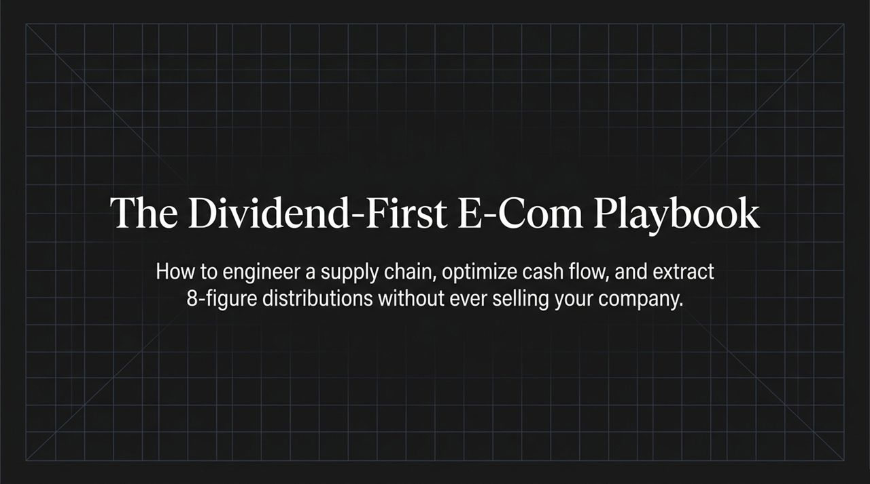
Notes:
Introduction: Welcome everyone. Today, we’re unpacking a core, fundamental shift in how e-commerce operators build, scale, and extract value from their businesses.
The Thesis: Most e-commerce founders fall into a trap: they scale top-line revenue, reinvest every dollar back into inventory, and pray for a massive exit down the line. But what if you never have to sell your business to realize multi-million-dollar wealth?
Core Focus: Over the course of this deck, we'll walk through a 4-pillar playbook designed to engineer your supply chain, unlock cash flow through payment terms, scale growth systematically, and run private-equity style monthly wealth extraction.
Key Takeaway: By the end of this session, you’ll see how to transform your supply chain into a working capital engine—turning your business into a true cash cow that serves you, rather than you serving it.
https://www.youtube.com/watch?v=SCJ9XYOQ-ho

Slide 2
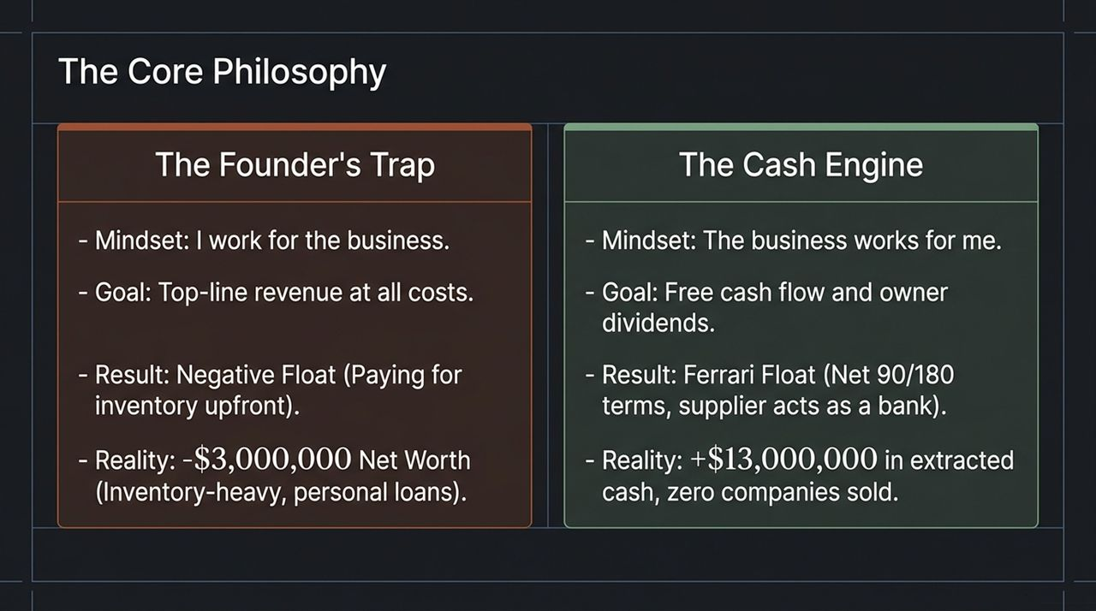
Notes:
The Founder's Trap: Let's look at the left column. Most founders operate under the mindset of 'I work for the business.' They focus strictly on top-line revenue, paying upfront for inventory, creating negative cash float. The reality? Many multi-million dollar brands have founders sitting at a negative net worth on paper because their cash is trapped in unsold stock or tied up in personal guarantees.
The Cash Engine Mindset: Now look at the right column. The shift is simple: 'The business works for me.' Instead of chasing top-line revenue at all costs, the target is repeatable free cash flow and cash distributions.
Ferrari Float: By negotiating favorable terms with suppliers—what we call the 'Ferrari Float'—suppliers essentially act as your bank. You sell goods before paying for them, driving cash directly into your personal vault without ever needing an exit.

Slide 3
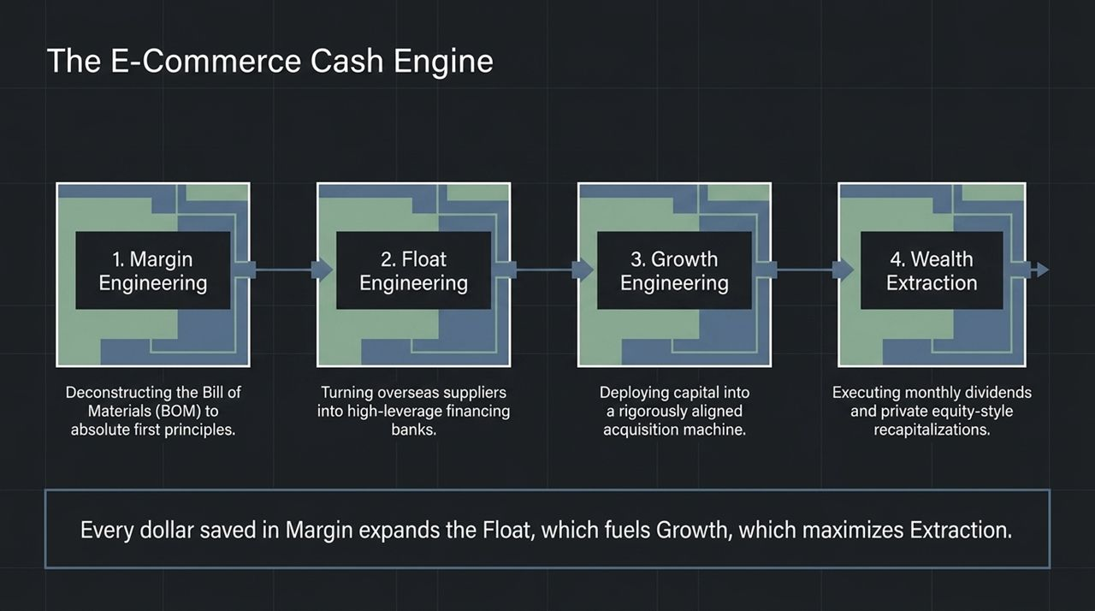
Notes:
Overview of the 4 Pillars: To achieve consistent distributions, we execute across four interconnected pillars: Margin, Float, Growth, and Wealth Extraction.
Pillar 1 - Margin Engineering: Deconstructing your Bill of Materials (BOM) down to first principles—raw materials, sub-vendors, and assembly costs.
Pillar 2 - Float Engineering: Turning suppliers into financing entities by using credit insurance and supply chain factoring to secure 90+ day terms.
Pillar 3 - Growth Engineering: Deploying capital into aggressive offers, novel hooks, and ad-to-landing-page alignment to maintain acquisition efficiency.
Pillar 4 - Wealth Extraction: Systematizing monthly dividend wires on the 15th of every month and leveraging dividend recapitalizations.
The Flywheel: Remember: Every dollar saved in Margin expands your Float, which fuels profitable Growth, maximizing your monthly Extraction.

Slide 4
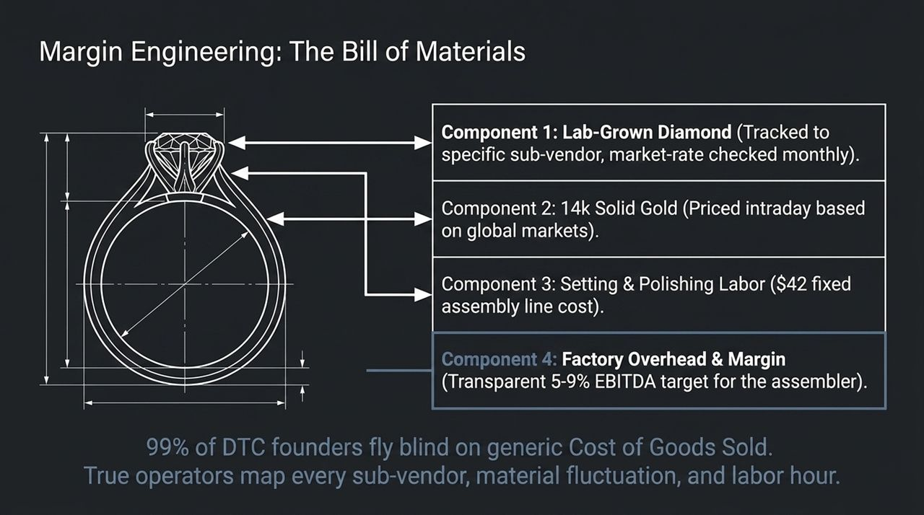
Notes:
The Problem with Generic COGS: 99% of DTC founders look at Cost of Goods Sold as a single, static figure given by a supplier. That is flying blind.
First Principles Breakdown: True operators map every component down to the sub-vendor level. Take this ring as an example:
Component 1: Lab-grown diamond tracked to specific sub-vendors and price-checked monthly.
Component 2: 14k Solid Gold priced intraday based on spot markets.
Component 3: Fixed labor costs ($42 for setting and polishing).
Component 4: Factory Overhead & Margin, transparently capped at 5–9% EBITDA for the assembler.
Actionable Insight: When you know the line-item costs better than the assembly plant, you can negotiate directly with component sources, protecting your margin when market rates shift.

Slide 5
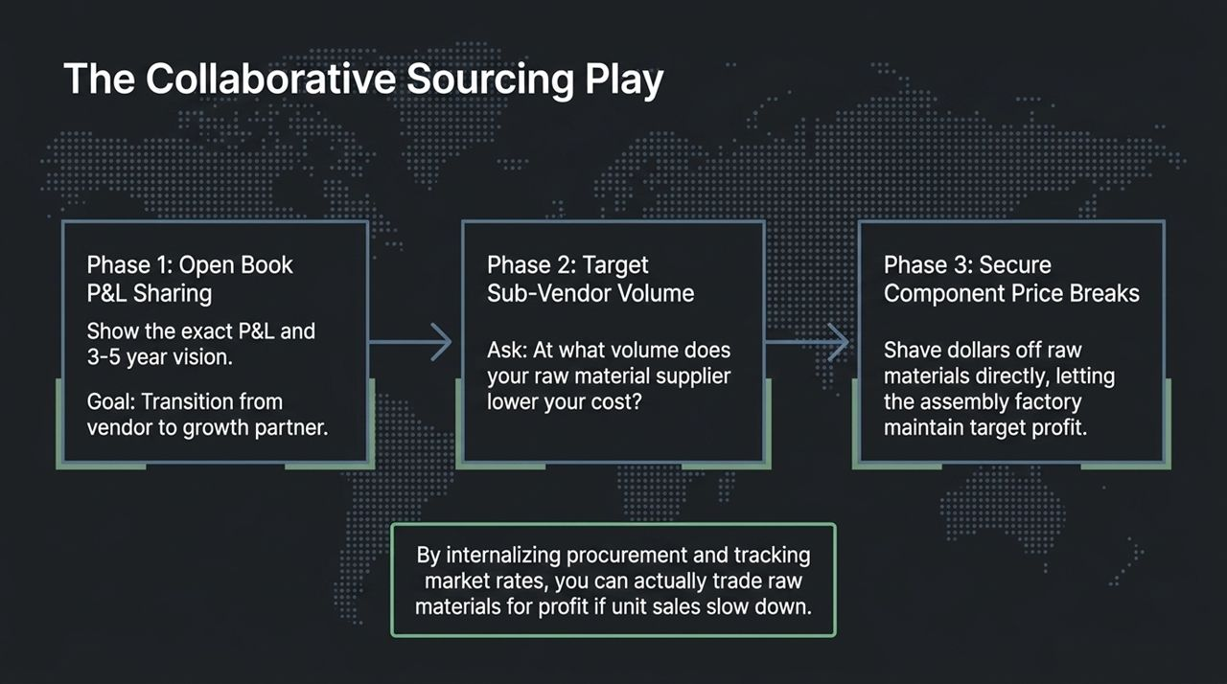
Notes:
Phase 1 (Open Book P&L): Building leverage starts with radical transparency. Show your primary supplier your P&L and 3-to-5-year volume targets. Align them as a long-term growth partner rather than a vendor.
Phase 2 (Sub-Vendor Volume): Ask the assembler: 'At what volume tier does your raw material vendor drop price breaks?' Identify those inflection points.
Phase 3 (Securing Price Breaks): Work directly with sub-tier suppliers to secure raw material price breaks. The assembly factory keeps their target 5–9% operational margin, while your total unit cost plummets.
Strategic Advantage: Internalizing procurement and tracking raw material market rates allows you to maintain margin stability even if sales volume temporarily flattens.

Slide 6
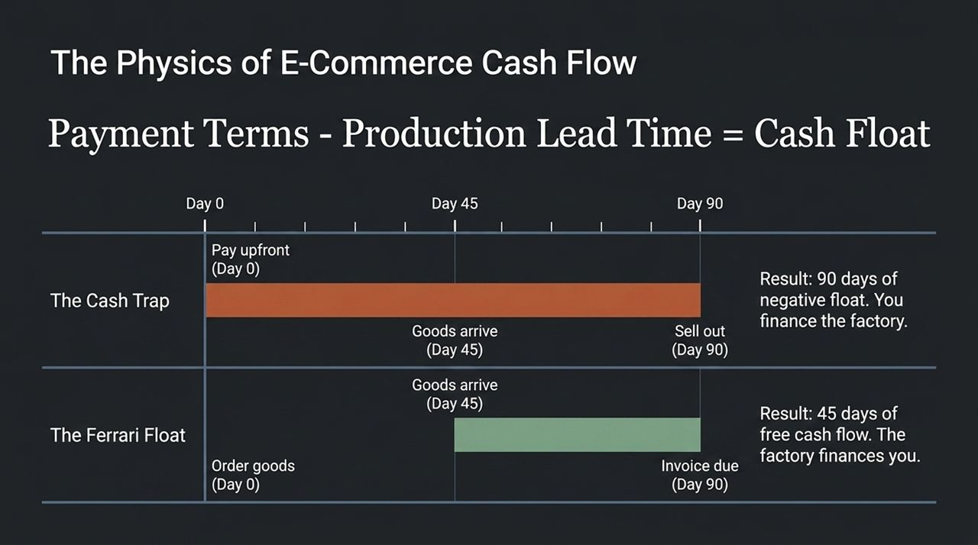
Notes:
The Formula: Cash Float = Payment Terms – Production/Delivery Lead Time.
The Cash Trap (Top Bar): If you pay 100% upfront on Day 0, and goods take 45 days to arrive and 45 days to sell, you spend 90 days in negative float. You are essentially funding the factory’s balance sheet with your own capital.
The Ferrari Float (Bottom Bar): Now imagine placing the order on Day 0 with Net 90 payment terms. Goods arrive at Day 45, and you sell through them by Day 90. The invoice is due on Day 90, meaning you operated for 45 days with positive free cash flow.
Core Impact: In the Ferrari Float scenario, your sales fund your working capital before the supplier ever gets paid. The factory becomes your primary lender.

Slide 7
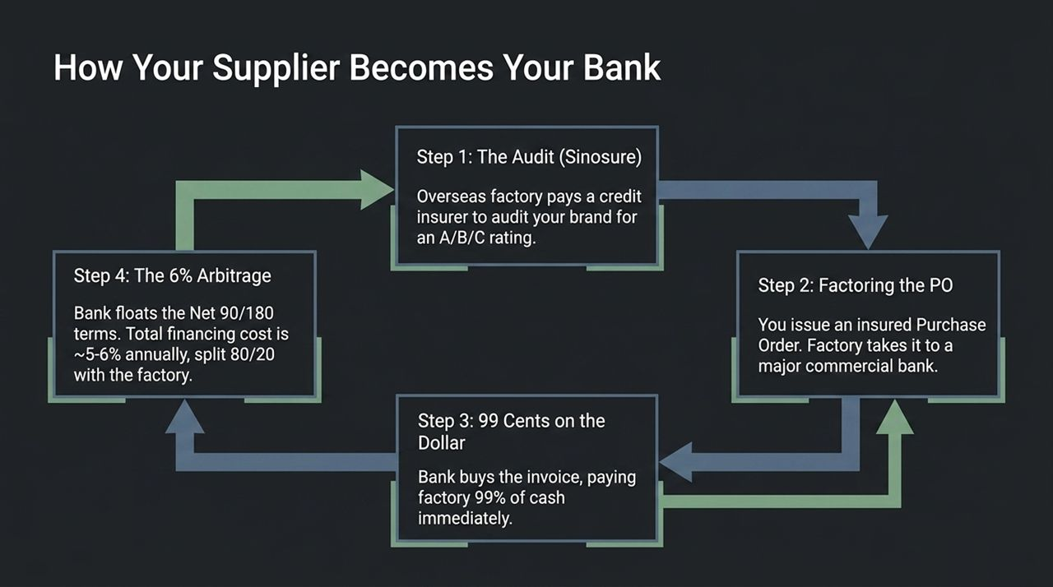
Notes:
Step 1 (Sinosure Audit): Overseas credit agencies like Sinosure audit your business finances to grant you a credit rating (A/B/C).
Step 2 (Factoring the PO): Once rated, you issue an insured Purchase Order. Your factory takes this PO to a commercial bank.
Step 3 (99 Cents on the Dollar): The bank factors the invoice, immediately paying the factory ~99% of the cash upfront, removing default risk for the supplier.
Step 4 (The 6% Arbitrage): The bank extends Net 90 or Net 180 terms to you. The annual financing fee is roughly 5–6%, which is often split between you and the factory.
Bottom Line: You get extended payment terms without taking on expensive equity dilutive capital or high-interest short-term debt.

Slide 8
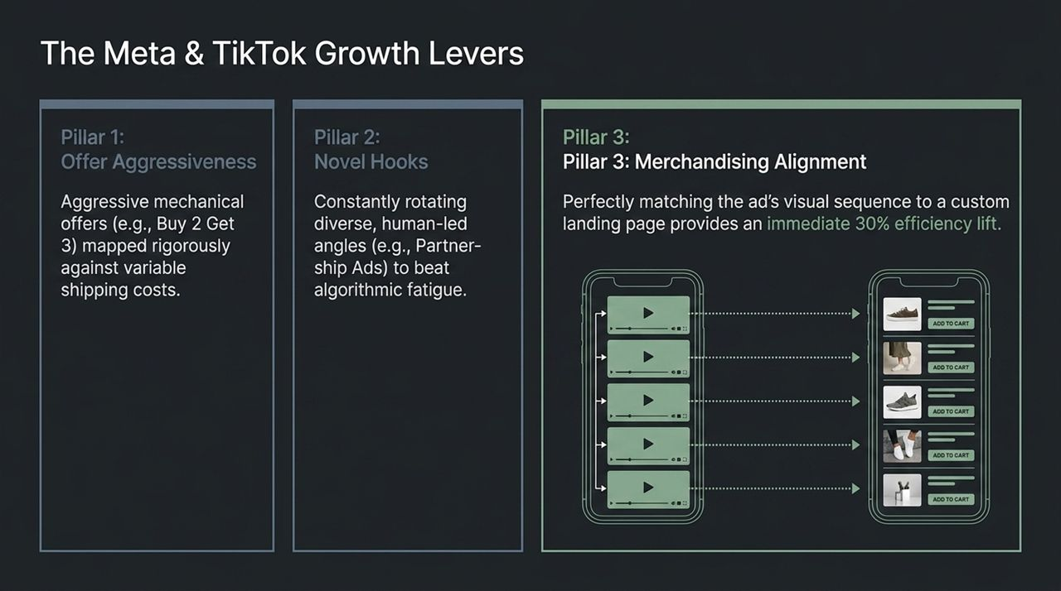
Notes:
Pillar 1 (Offer Aggressiveness): To drive velocity, structure aggressive mechanical offers (e.g., Buy 2 Get 3) mapped precisely against your shipping and fulfillment margins.
Pillar 2 (Novel Hooks): Combat creative fatigue by constantly rotating diverse, human-led ad formats—such as Partnership Ads or creator whitelist campaigns.
Pillar 3 (Merchandising Alignment): Ensure strict visual congruence. The exact visual sequence shown in the top-performing ad must immediately match the landing page hierarchy.
Result: Matching visual context between the creative hook and the landing page routinely yields a 30%+ lift in conversion efficiency.

Slide 9
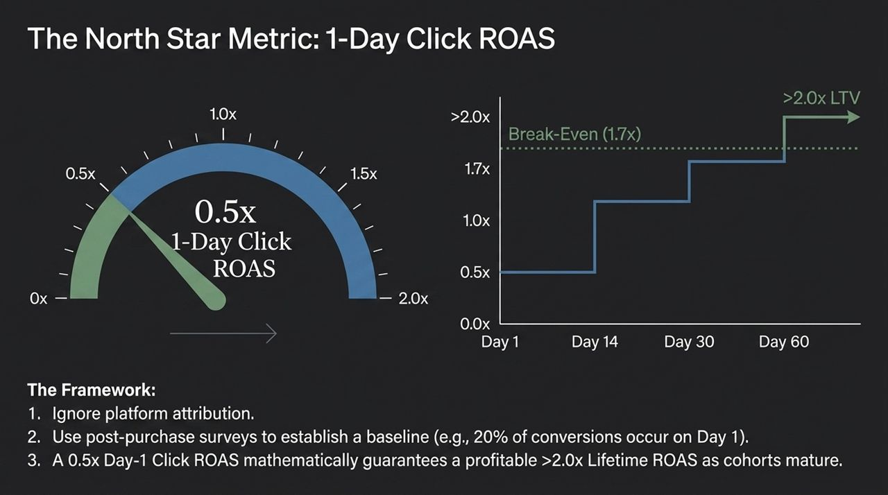
Notes:
Step 1 (Ignore In-Platform Attribution): Platform-reported attribution models can be misleading and noisy.
Step 2 (Post-Purchase Survey Baseline): Use post-purchase zero-party data to establish your true Day-1 conversion baseline (e.g., discovering that 20% of total cohort LTV occurs on Day 1).
Step 3 (Mathematical Guarantee): Once your cohort maturation curves are proven, hitting a targeted 0.5x 1-Day Click ROAS mathematically guarantees a profitable >2.0x LTV by Day 60.
Takeaway: This gives media buyers an objective daily target without waiting weeks for attribution windows to clear.

Slide 10
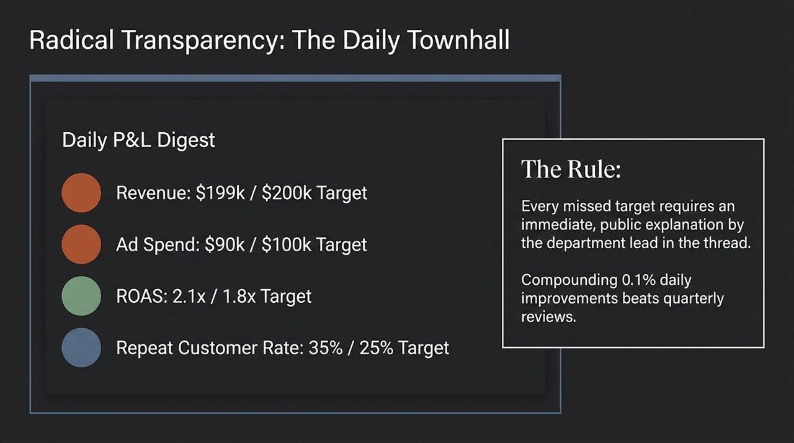
Notes:
Daily P&L Digest: Every morning, publish a full P&L dashboard across company channels showing real-time performance vs targets: Revenue, Ad Spend, ROAS, and Repeat Customer Rate.
The Core Rule: If any department misses a daily key metric, the respective team lead must post a public explanation and corrective action plan in the thread.
Cultural Shift: This eliminates passive management. Compounding small 0.1% daily adjustments drives far greater performance than quarterly post-mortems.

Slide 11
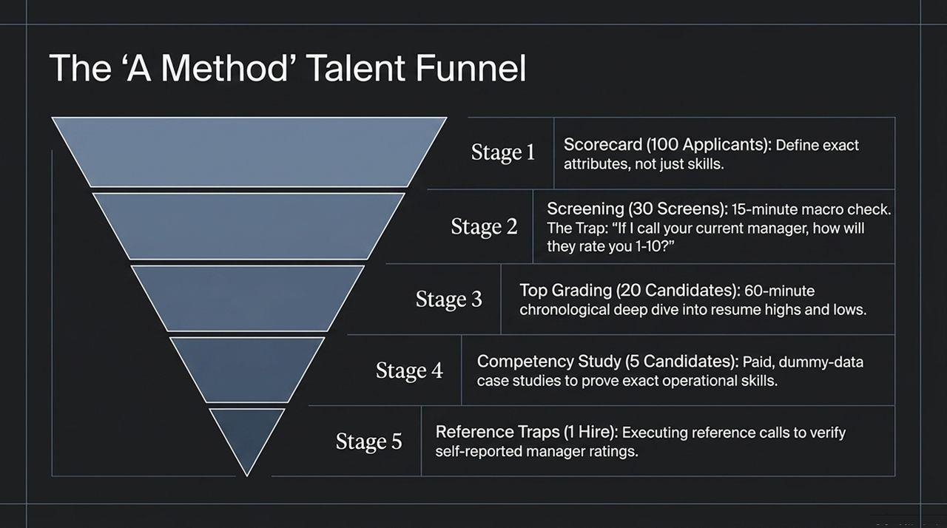
Notes:
Stage 1 (Scorecard): Define exact measurable outcomes and attributes for the role rather than generic skill descriptions.
Stage 2 (Screening): Conduct 15-minute macro screens. Ask: 'If I call your current manager, how will they rate your performance 1-10?'
Stage 3 (Top Grading): A 60-minute deep dive across their career history to identify patterns of performance.
Stage 4 (Competency Study): Pay top 5 candidates to complete real-world, dummy-data case studies to verify execution skills.
Stage 5 (Reference Traps): Execute reference calls with past supervisors to validate the scores given during Stage 2.

Slide 12
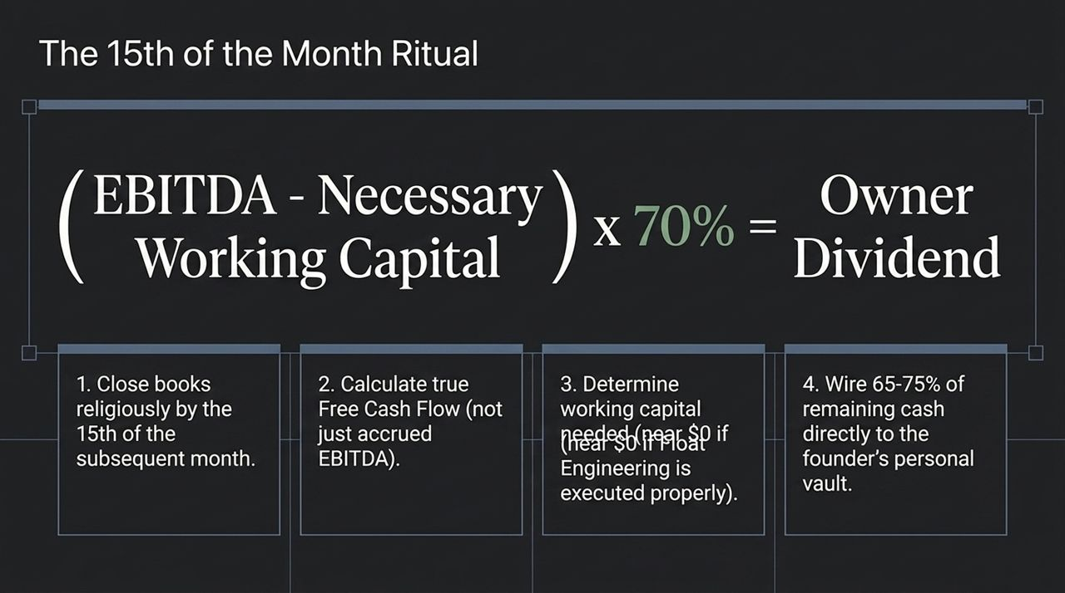
Notes:
Step 1 (Strict Monthly Close): Mandate that your financial books are fully closed by the 15th of every month.
Step 2 (Free Cash Flow Calculation): Calculate true Free Cash Flow—not just accrued accounting EBITDA.
Step 3 (Working Capital Holdback): Subtract necessary working capital reserves (which should be minimal if Float engineering was executed).
Step 4 (Owner Wire): Wire 65–75% of remaining cash directly out of the business into the founder’s personal vault.

Slide 13
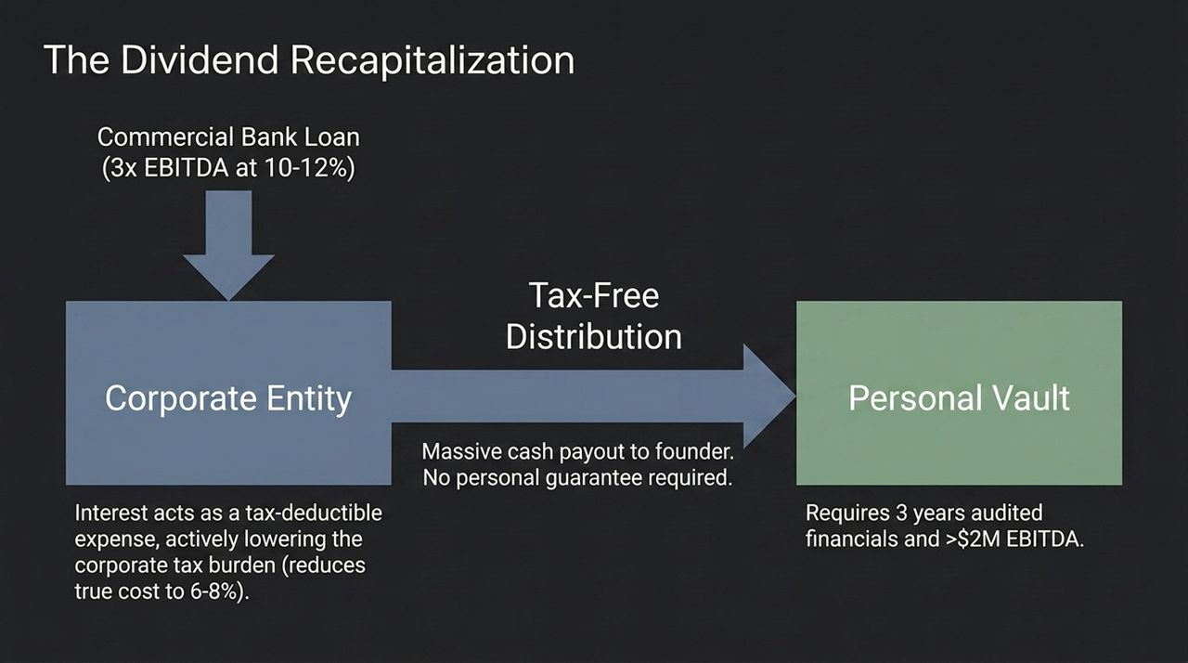
Notes:
How It Works: Once the company achieves 3 years of audited financials and >$2M EBITDA, leverage a senior commercial bank loan (typically 3x EBITDA at 10–12%).
Tax-Free Distribution: Distribute the loan proceeds directly to the founder as a tax-free capital return/dividend recapitalization.
Corporate Tax Advantage: Interest payments on the bank loan act as a tax-deductible expense for the operating company, effectively lowering corporate tax exposure and reducing the net cost of debt to ~6–8%.
Personal Protection: Executed properly at scale, these commercial facilities require zero personal guarantees.

Slide 14
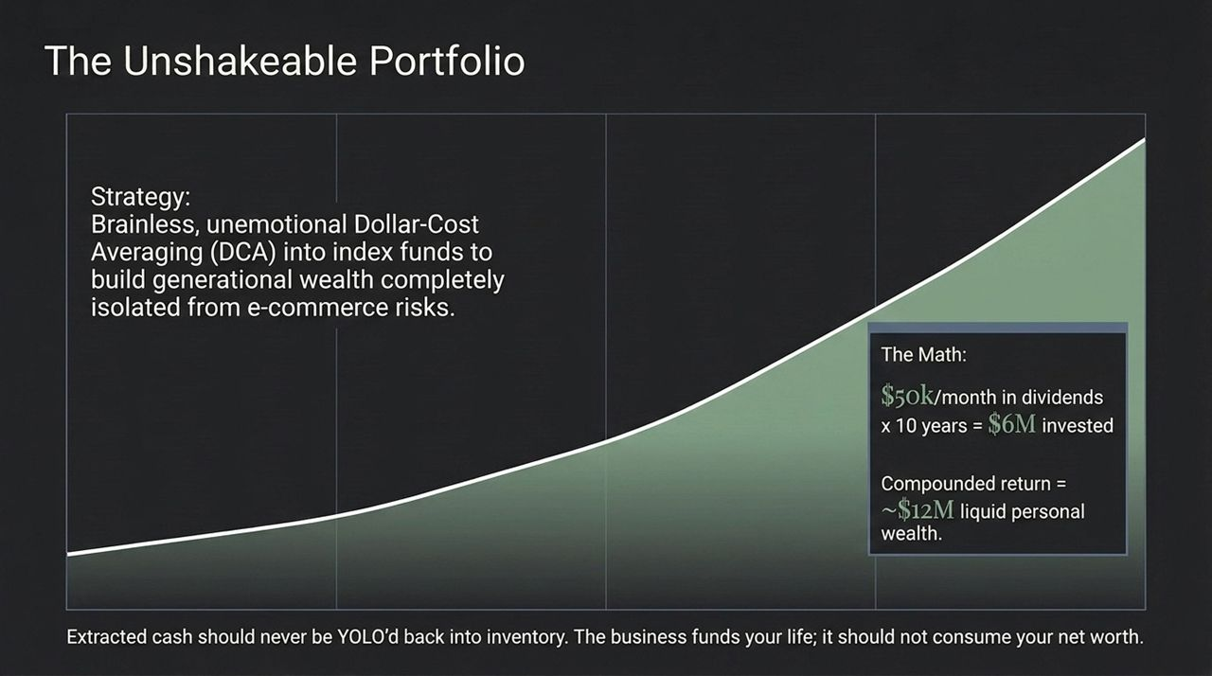
Notes:
The Strategy: Extracted wealth should never be reinvested back into inventory or risky operational bets. Use systematic Dollar-Cost Averaging (DCA) into broad index funds to decouple personal net worth from e-commerce operational risk.
The Math: Extracting $50k/month into index funds over 10 years equals $6M invested, compounding into ~$12M of liquid, personal wealth independent of your business.
Principle: The business exists to fund your life—not consume your personal net worth.

Slide 15
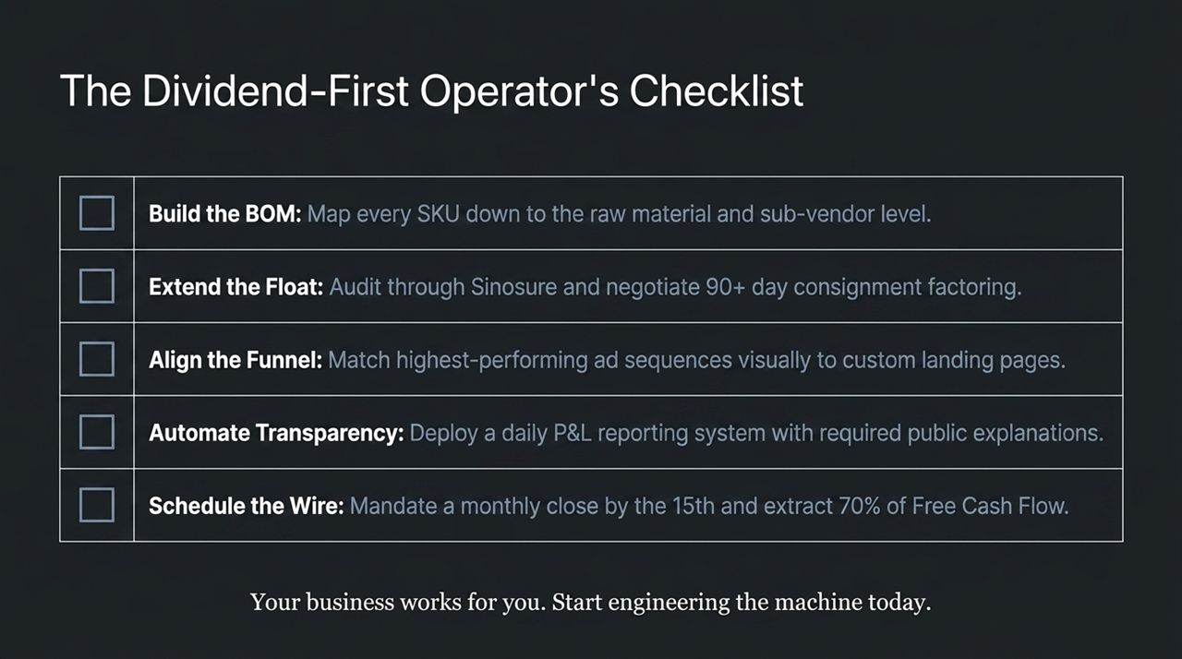
Notes:
Summary of Actions: To recap our execution roadmap:
BOM: Map every SKU down to raw materials and sub-vendors.
Float: Obtain Sinosure credit audits and target 90+ day terms.
Growth: Match high-performing ad sequences visually to custom landing pages.
Operations: Enforce daily P&L transparency and public variance explanations.
Wealth: Close books by the 15th and wire 70% of Free Cash Flow to your personal accounts.

Slide 16
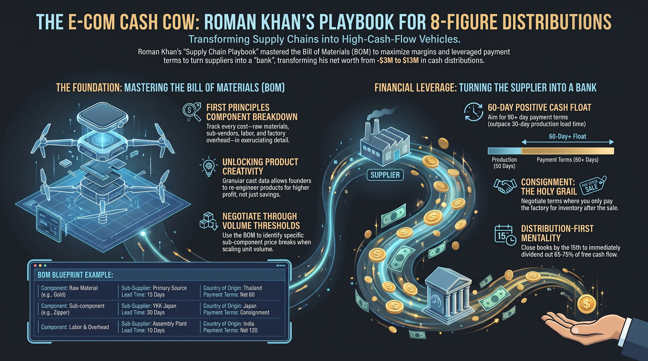
Notes:
Final Synthesis: This summary graphic ties together everything we discussed today.
Key Takeaway 1: Master the Bill of Materials to unlock true margin visibility and negotiate volume breaks directly with sub-suppliers.
Key Takeaway 2: Engineer a 60-day positive cash float so that production finishes and sales occur before supplier invoices come due.
Key Takeaway 3: Operate with a distribution-first mentality: systematically extract 65–75% of monthly free cash flow by the 15th of every month.
Closing Quote: Remember Roman Khan’s core principle: Transform your supply chain into a high-cash-flow vehicle, turn your suppliers into your bank, and build true wealth without ever having to sell your company.

